Slide 1
Java Virtual Machine (JVM) - Detailed Explanation
Understanding JVM Architecture, Execution Process, and Memory Management

Slide 2

What is JVM?
JVM (Java Virtual Machine) is a virtual engine that runs Java programs by converting bytecode into machine code.
Key Features:
Platform Independent
Automatic Memory Management (Garbage Collection)
Security and Performance Optimization

Slide 3

JVM Architecture
JVM consists of:
Class Loader Subsystem
Runtime Data Areas
Execution Engine
Native Interface
Garbage Collector

Slide 4
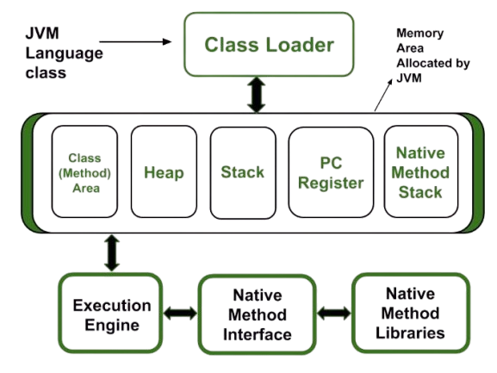

Slide 5
Class Loader Subsystem
Loads Java classes into memory and performs:
Loading: Reads .class files
Linking: Verifies and prepares classes
Initialization: Initializes static variables
Types:
1. Bootstrap Loader
2. Extension Loader
3. Application Loader

Slide 6
JVM Memory Areas
Method Area : Stores class metadata and static variables
Heap Area : Stores objects and instance variables
Stack Area : Stores method execution and local variables
PC Register : Tracks current instruction
Native Method Stack : Manages native (C, C++) method calls

Slide 7
Execution Engine
Executes bytecode using:
Interpreter : Translates bytecode line-by-line
Garbage Collector : Removes unused objects from Heap
JIT Compiler : Converts bytecode into native machine code for better performance.

Slide 8
JVM Execution Process
Compilation : Java code -> Bytecode (.class file)
Class Loading : Loaded into Method Area
Memory Allocation : Objects in Heap, Methods in Stack
Execution : Using JIT Compiler or Interpreter
Garbage Collection : Unused objects removed

